Slide 1
Chapter 22: Factor Analysis
Textbook: Ahmad Daryanto, Introduction to Quantitative Research Methods for Marketing With SPSS and R: Tools and Techniques, Routledge. 2024

Slide 2
Learning Objectives
Understand the basic principles of EFA
Understand the different between EFA and PCA
Understand the basic principles of CFA
Able to use SPSS and R to conduct EFA.
Know how to interpret the results of EFA.

Slide 3
EFA
Goal: To uncover underlying common factors of latent constructs.
EFA reduces and summarize data into a smaller set of dimensions

Slide 4
PCA vs Factor Analysis
PCA = Principal Component Analysis
PCA is listed under factor analysis options in SPSS, but theoretically it is not considered as a factor analysis technique.
PCA is data reduction technique where it seeks for minimum number of factors that account for the maximum amount of variance.
A principal component is just a linear weighted combination of several variables. That is, in PCA, the scores on the items are not caused by a latent construct – the scores create the principal component.
EFA = Exploratory Factor Analysis
EFA seeks to find latent factors that underlie pattern of correlation among observed variables in the data.
A latent construct or a common factor influences observed variables

Slide 5
EFA – conceptual structure
b₁
e1
V₁
F₁
b₂
e2
V₂
e3
V₃
b₃
F₂
b₄
e4
V₄
b₅
e5
V₅

Slide 6
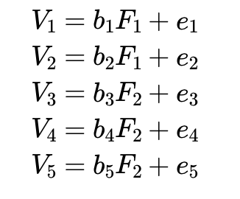
Mathematical Relationships

Slide 7
Steps in EFA
Step 1: Develop set of items to measure a latent construct and collect data via survey.
Step 2: Check the correlation matrix, check assumptions. • Items/variables should be correlated
Step 3: Factor Extraction.
Determining the smallest number of factors that can be used to best represent the interrelationship among set of items.
There are several options. We use principal axis factoring (PAF).
Step 4: Factor Rotation to increase interpretability.
Step 5: Interpretation.
Step 6. Conduct reliability analysis for each dimensions found (i.e., calculating Cronbach’s alpha)

Slide 8
Principal Axis Factoring (PAF)
One of the popular EFA techniques
PAF is PCA applied to correlation matrix with communalities estimates in the main diagonal
Squared multiple correlation (SMCs) can be used as the initial estimates of communality.
SMC associated with an item is just an R-square from regressing the item on the remaining variables
Using SMC as an initial estimate of communality, PAF will use an iterative procedure to extract common factor, estimate factor loadings, and calculate new communalities given the factors loadings.

Slide 9
EFA – Option 1 using SPSS syntax
MATRIX DATA
VARIABLES=ROWTYPE_ V1 V2 V3 V4 V5.
BEGIN DATA.
N 243 243 243 243 243
COR 1.000
COR .544 1.000
COR .333 .414 1.000
COR .186 .152 .560 1.000
COR .193 .213 .529 .593 1.000
END DATA.
FACTOR
/MATRIX=IN(COR=*)
/ANALYSIS V1 V2 V3 V4 V5
/DIAGONAL 0.312 0.367 0.466 0.444 0.409
/EXTRACTION PAF
/PLOT EIGEN ROTATION
/ROTATION OBLIMIN.

Slide 10
EFA – Option 2 using SPSS syntax
FACTOR
/VARIABLES V1 V2 V3 V4 V5
/MISSING LISTWISE
/ANALYSIS V1 V2 V3 V4 V5
/PRINT UNIVARIATE INITIAL KMO EXTRACTION ROTATION
/FORMAT BLANK(0.40)
/PLOT EIGEN ROTATION
/CRITERIA MINEIGEN(1) ITERATE(25)
/EXTRACTION PAF
/CRITERIA ITERATE(25) DELTA(0)
/ROTATION OBLIMIN
/SAVE REG(ALL)
/METHOD=CORRELATION.
Data: fa_qual.sav

Slide 11
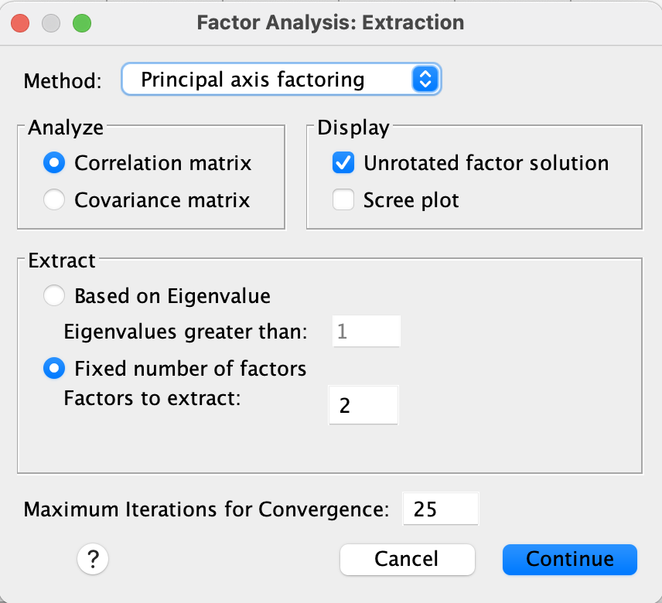
Specifying the numbers of factors to be extracted.
The number of common factors are set to 2.

Slide 12
Interpretation of The Outputs

Slide 13
Is it appropriate to use EFA?
To make sure that there is enough correlation in the data to justify using EFA for dimension reduction, the Bartlett’s sphericity test is used.
H0: The variables are mutually independent (EFA is inappropriate)
HA: The variables are not mutually independent (EFA is appropriate)
In our example, because p<0.05, H0 is rejected, therefore EFA is justified.

Slide 14
KMO-criterion
KMO-Criterion for the evaluation of the correlation matrix as a whole:
KMO ≥ 0.9 “excellent“
KMO ≥ 0.8 “deserving“
KMO ≥ 0.7 “quite good“
KMO ≥ 0.6 “moderate“
KMO ≥ 0.5 “miserable“
KMO < 0.5 “unbearable”
Thus, according to Kaiser, the threshold is 0.5
Cerny, C.A., & Kaiser, H.F. (1977). A study of a measure of sampling adequacy for factor-analytic correlation matrices. Multivariate Behavioral Research, 12(1), 43-47.
Kaiser, H. 1974. An index of factor simplicity. Psychometrika 39: 31–36.

Slide 15
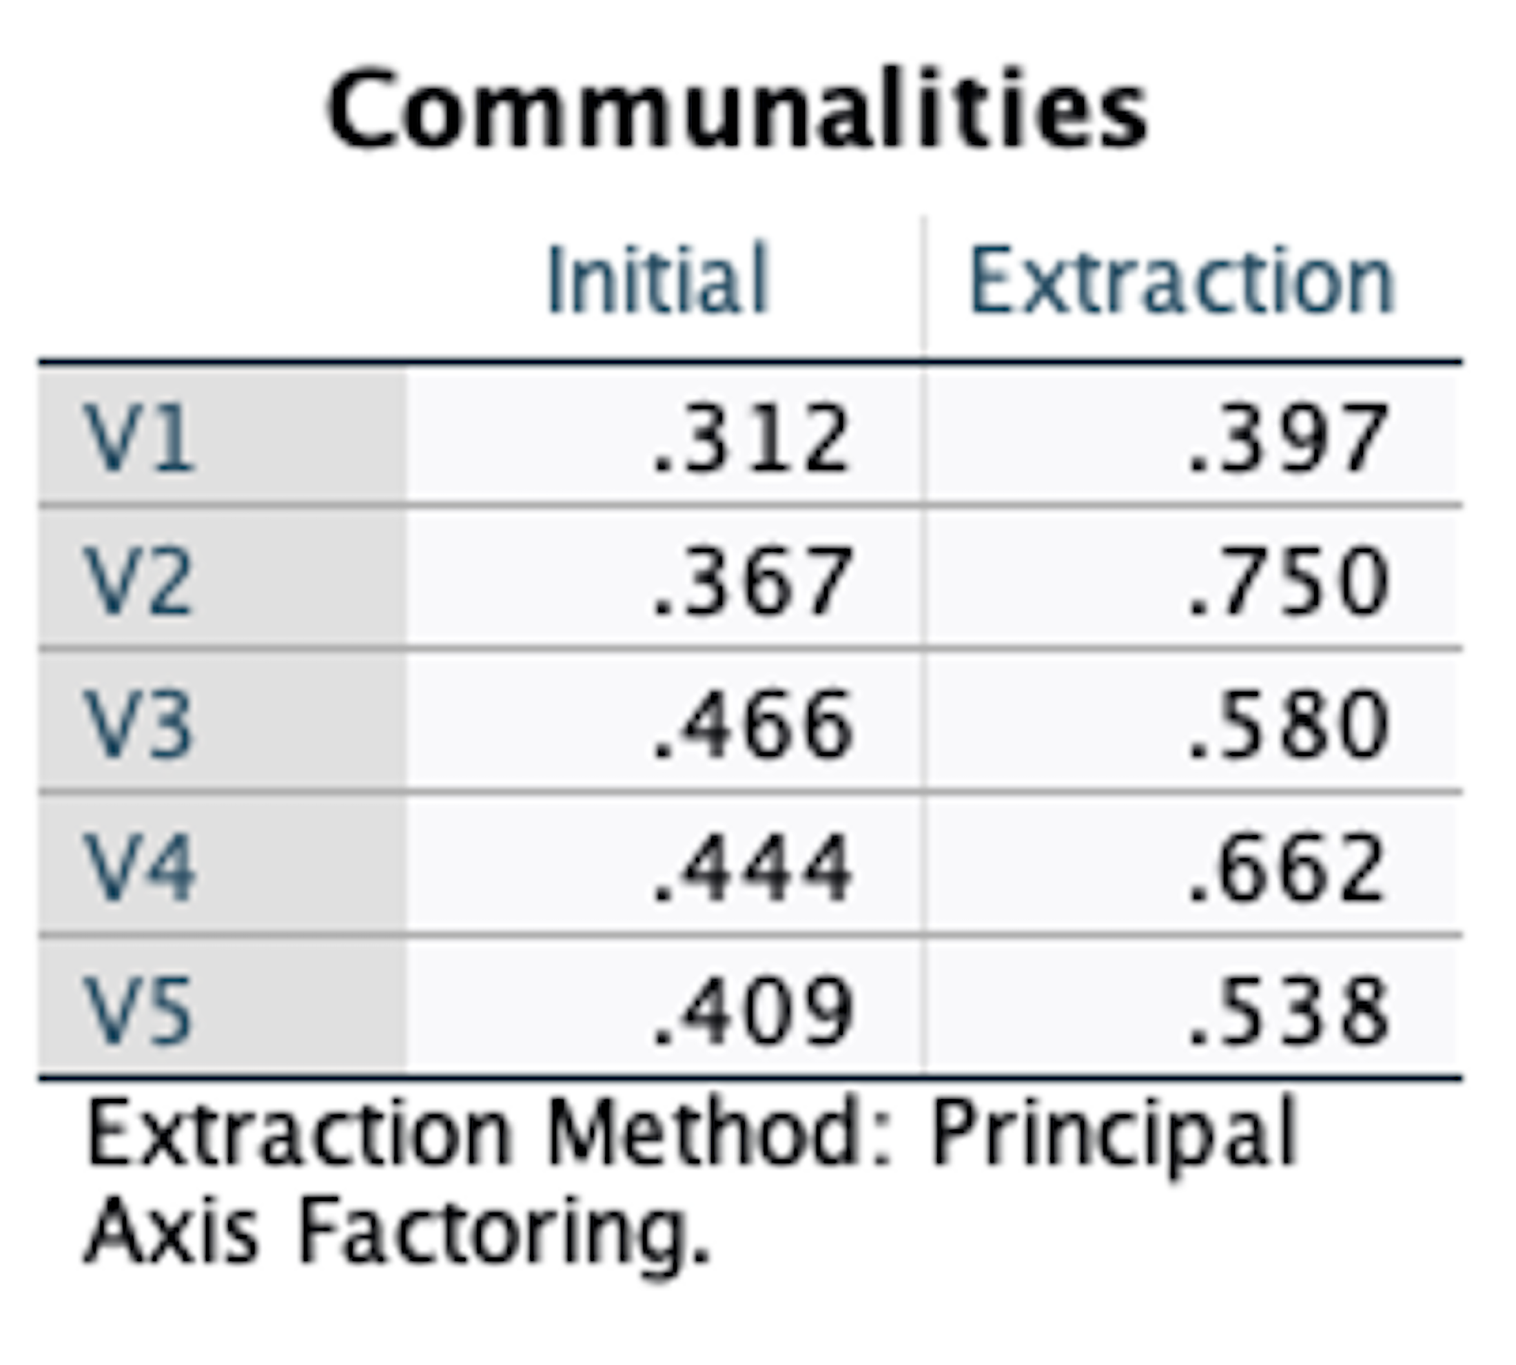
Communality
Proportion of variance in the item that is accounted for by the common factors.
Variance = Common variance + unique variance (specific + error)
If communality of an item is high, this means that the common factors can strongly explain the variation in the item. In other words, the common factors have a strong influence the item.

Slide 16
Communality
Unrotated
Direct Oblimin

Slide 17
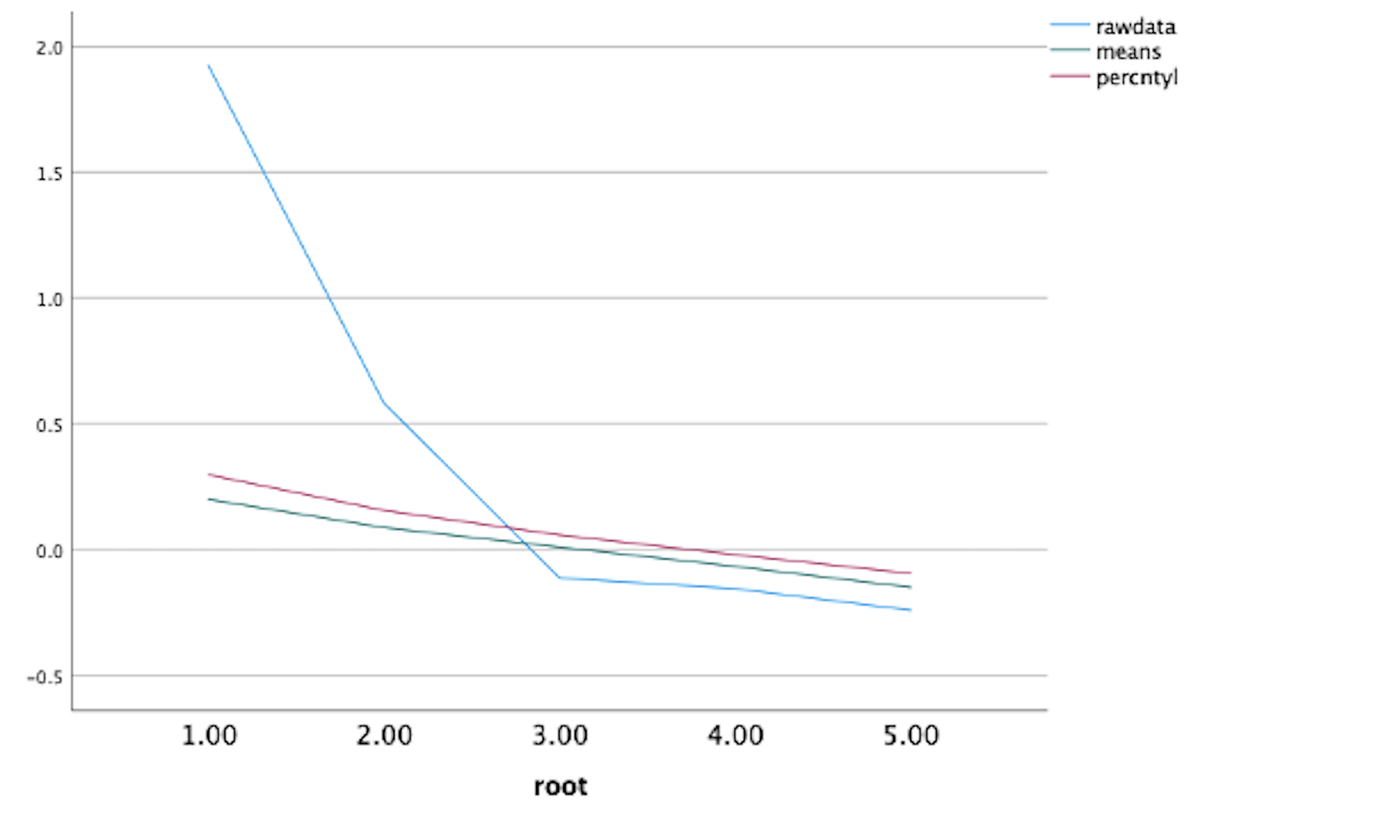
How Many Factors To Retain?
Kaiser’s rule (eigen value > 1)
Scree plot
Horn’s parallel analysis
A scree plot of the actual and the scree plot of the means and the 95 percentiles eigen values also suggest that 2 factors can be retained.

Slide 18
Scree plot

Slide 19
Horn’s Parallel Analysis
A scree plot of the actual and the scree plot of the means and the 95 percentiles eigen values also suggest that 2 factors can be retained.

Slide 20
Total variance explained (EFA) Rotation: Direct Oblimin
Proportion of variance accounted
for by two PCs before rotation
Sum of the percentage variance

Slide 21
Total variance explained (EFA) Rotation: Varimax
Proportion of variance accounted for by two PCs before rotation
Sum of % variance

Slide 22
Factor Matrix
Unrotated solution
If you looked at the factor loadings greater than 0.4, it seems that all items contribute to the first factor and crossloadings occur for two items (V2 and V4), one of which has a negative sign (V4). If we choose to show loadings greater than 0.3, crossloading can also easily be visible for V1. This result is not easy to interpret. It does not provide a clear indication of the presence of a simple structure

Slide 23
Factor Plot Of Unrotated Solution
Rotated Factor 2
Rotated Factor 1
The factor loadings constitute the coordinate of items in a factor plot

Slide 24
Factor Plot Of Rotated Solution
The ROTATION argument in subcommand /FORMAT produces a factor plot of the rotated solutions in which Factor 1 and the rotated Factor 2 become the new axes.

Slide 25
Pattern Matrix
Patten matrix and structure matrix are tables specifically printed when oblique rotation such as direct oblimin is used. You will not obtain these tables if you used an orthogonal varimax rotation.
The loadings in each row of the pattern matrix is obtained by regressing the item– in a standardized form, on the factors. As there are two factors extracted in our example, the coefficients capture the influence of a factor on an item when another factor is held constant. Taking the square of the coefficient, it represents the amount of variance explained by a factor holding other factor constant.

Slide 26
Structure Matrix
The loadings in the structure matrix can be interpreted as the correlation between the correlation between the items and the factors.
If the factors are uncorrelated the pattern matrix and the structure matrix is the same

Slide 27
Factor Correlations
This coefficient is printed automatically when the oblique rotation is chosen as the factor rotation method.
Structure matrix = Pattern matrix × Factor correlations

Slide 28
R Action
Use the fa() function from the psych package (Revelle et al., 2018).
Before you start your R session with EFA, install two R packages: 1. psych package (install.packages(psych)) which contains the fa() function,
2. GPArotation rpackage

Slide 29
R Action
rm(list=ls()) # make a fresh start
library(haven) # to read SPSS data
library(psych) # load the psych package
dat <- read_sav("/Users/ahmaddaryanto/Documents/Data1/fa_qual.sav")
rcor <- cor(dat)
KMO(rcor)
cortest.bartlett(rcor, n = 243)
fa.parallel(dat, fm="pa", fa="fa", n.obs=243, main="Parallel Analysis Scree Plots")
fa_res <- fa(dat, fm="pa", nfactors = 2, rotate = "oblimin")
fa_res$communality
print(fa_res$loadings, cutoff = 0.4)
print(fa_res$Structure, cutoff = 0.4)
fa_res$Phi
fa.diagram(fa_res, digits=3)
fs_scores <- factor.scores(dat, fa_res,method="Thurstone")
head(fs_scores$scores)

Slide 30
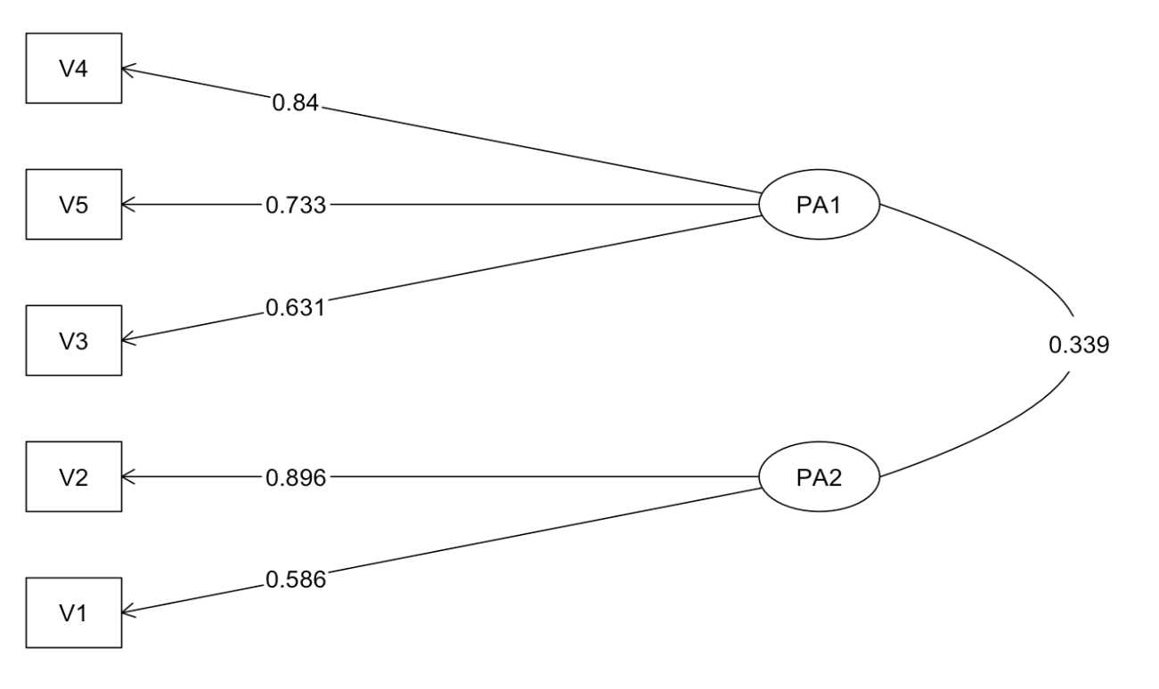
R Action
fa.diagram(fa_res, digits=3)

Slide 31
Key issues in EFA
Is there enough correlations among variables in the data?
How many dimensions/factors will be retained?
What are appropriate name for the common factors?
How would you use the newly created variables (ie factors) for further analysis?

Slide 32
A Glimpse of CFA
EFA = Exploratory Factor Analysis
Identify the underlying relationship between variables
By definition, EFA is exploratory, i.e., you don’t have a prior knowledge/theory how variables relate to latent constructs.
Can be done in SPSS, which is our focus in this lecture.
CFA = Common Factor Analysis
Identify the underlying relationship between variables
Theory-driven: you define which variables relate to which specific latent constructs .
Software: AMOS, LISREL, Mplus, R package lavaan

Slide 33
Fundamental Of CFA
The goal in CFA is to determine how well a proposed CFA model aligns with observed data. CFA will compare the predicted covariance matrix of observed variables Σ with the sample covariance matrix S. A good fit occurs when Σ and S do not differ greatly. A perfect occurs when Σ=S. However, perfect fit never happens in a real-life setting.

Slide 34
Illustration
Sustainable consumption scale (e.g., Balderjahn et al. (2013))
I now buy clothing that is durable (SFC1).
It is made from recycled materials? (SFC2).
I will buy clothing that is safe to the environment (SFC3).
I will not buy new clothing items, if I already have previous dresses in usable state (SFC4).

Slide 35
lavaan code
rm(list = ls(all=TRUE)) # make a fresh start
library(haven)
library(lavaan)
library(lavaanPlot)
library(semTools)
dat <- read_sav("/Users/ahmaddaryanto/Documents/Data1/sfc.sav")
sfc_model <- '
SFC =~ SFC1 + SFC2 + SFC3 + SFC4
'
fit <- cfa(sfc_model, data=dat)
summary(fit, standardized=TRUE)
fitMeasures(fit,c("chisq","df","rmsea","srmr","cfi","tli"))

Slide 36
lavaan code
# plotting the CFA path model
labels = list(SFC = "SFC")
pl <- lavaanPlot(model = fit, labels = labels,
graph_options = list(rankdir = "TB"),
node_options = list(shape = "box",
fontname = "Helvetica"),
edge_options = list(color = "grey"),
coefs = TRUE, stand = TRUE)
pl
# calculate composite reliability
reliability(cfa.fit)

Slide 37
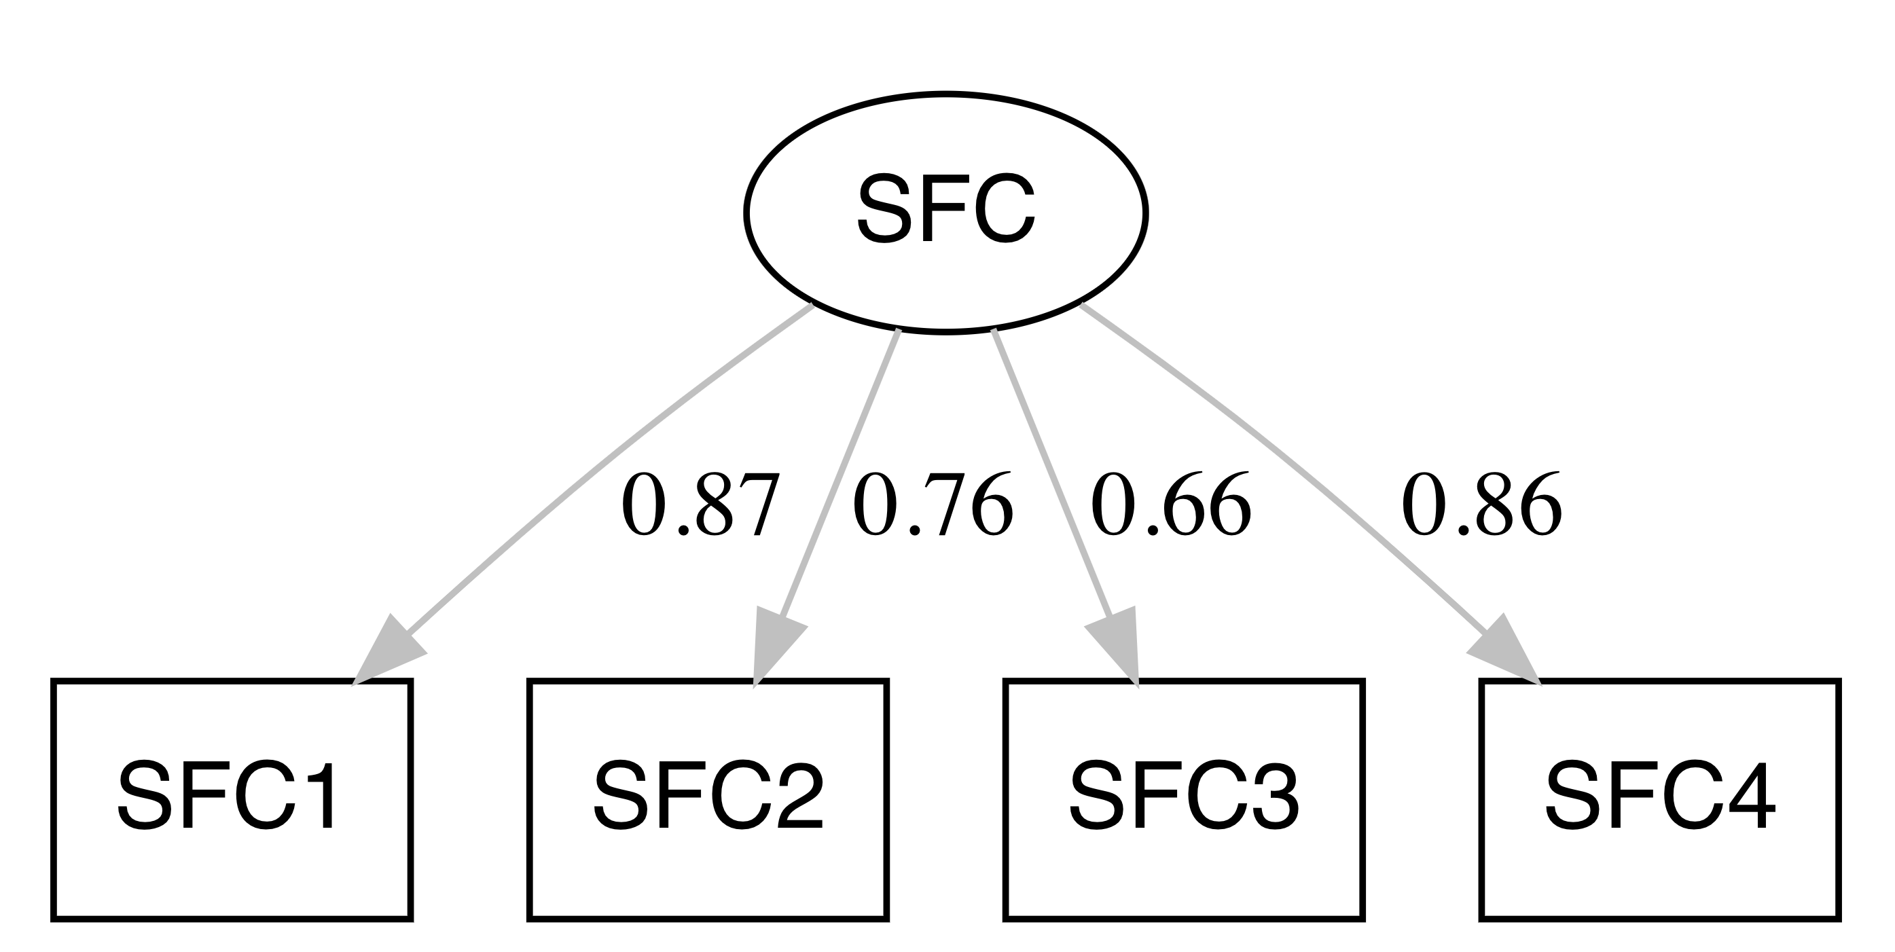
Confirmatory Factor Analysis (CFA)
Data: sfc.sav

Slide 38
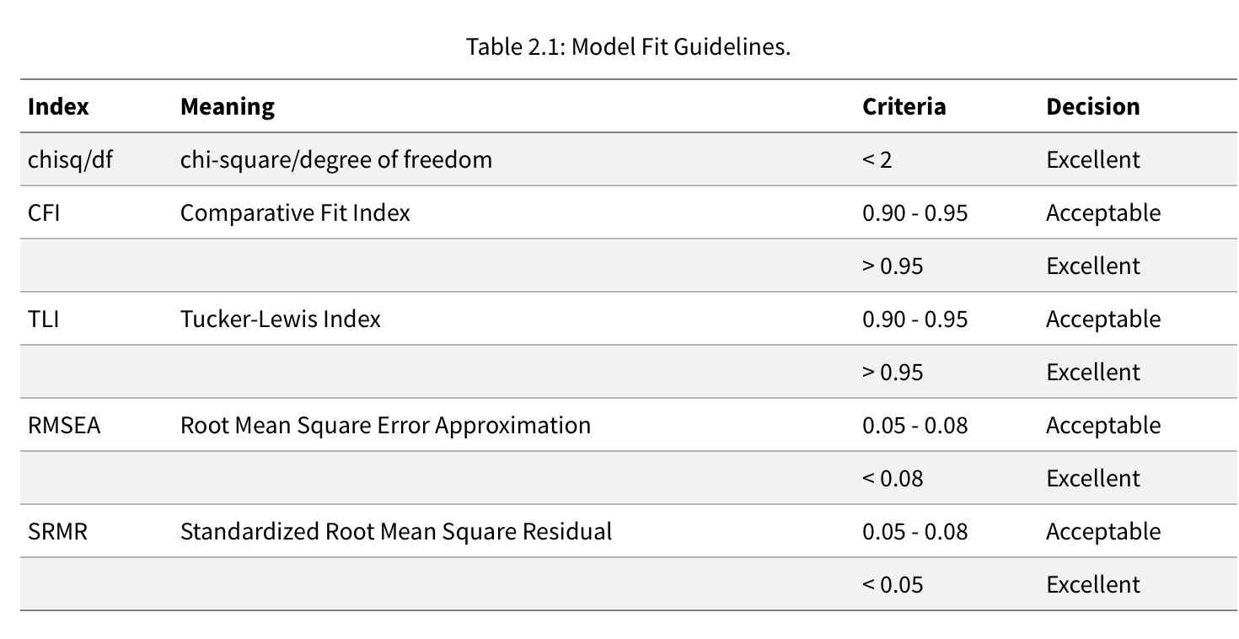
Model Fit Guidelines
Hu and Bentler 1998

Slide 39
Further Readings
Brown, T. A. (2015). Confirmatory factor analysis for applied research. Guilford publications. This is a defining text on CFA. early chapters covered EFA.
Daryanto, A., Song, Z., & Soopramanien, D. (2022). The COVID-19 pandemic as an impetus for pro-environmental behaviours: The role of causal attribution. Personality and Individual

